Slide 1
Lesson 1
CAN Protocol Basics
Notes:
1) Xin chao moi nguoi, cam on moi nguoi da tham gia vao khoa hoc FuSa
Buoi hom nay la ve phan session 1, overview ve FuSa
2) Truoc em cung gui tai lieu ve FuSa, anh chi em thay the nao. Tai lieu co de hieu khong ah, cam giac FuSa co de khong ah.
3) Em xin phep buoi nay nhu chia se kien thuc, kinh Nghiem ve FuSa.
Cac anh chi em da co kinh Nghiem lau nam, nen neu co gi khiem khuyet xin cac anh chi em dai xa cho

Slide 2
Contents
CAN introduction
CAN Properties
CAN features
CAN bus and Network Topology

Slide 3
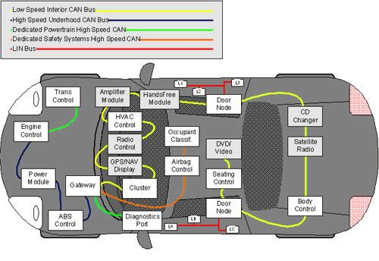
1/ CAN introduction - What is CAN?
Controller
Area
Network
The Controller Area Network (CAN bus) is the nervous system, enabling communication between nodes.

Slide 4
1/ CAN introduction - Why CAN?
Automotive Domain needed a way for all ECUs to communicate the data among themselves.
Communication could be started by any node –Asynchronous|Multimaster
Highly immune to electrical noise – Dual twisted pair
Short latency period – Small frame size (8bytes data)
Simple & low cost
Many more reasons

Slide 5
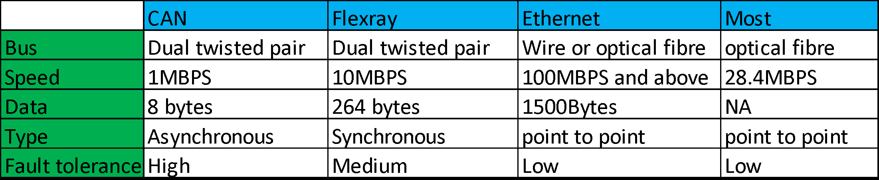
1/ CAN introduction - Comparing CAN with other protocols
Each node has to wait for their turn to start sending data
Not suitable. Usually used for high chunk of data
Optical fiber can not be bent easily.
-> There is a limit
Will make the automotive network become complex
Low trust
Notes:
MOST: used for video/audio streaming

Slide 6
2/ CAN Properties
AGENDA
Wired – Wireless
Serial – Parallel
Synchronous – Asynchronous
Peer2Peer – Broadcast
Message Based Protocol
Message Filtering
Simplex – Half Duplex – Full Duplex
Acknowledgement method
CSMA-CA Protocol
Temporary and Permanent Node failures

Slide 7
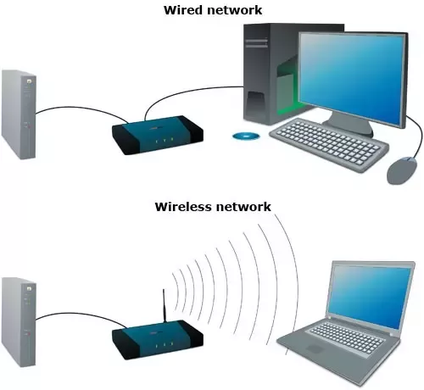
Wired and Wireless Communication
Telephone is Wired and Mobile is wireless
Wireless Protocols
Bluetooth,
WIFI
Wired Protocols
Ethernet
CAN
When we go for Wired and when we go for Wireless?
CAN is a Wired Protocol – Bus Topology

Slide 8
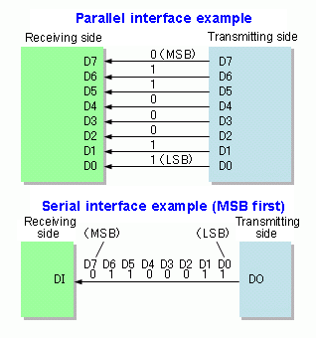
Serial and Parallel Communication
How many bits can the bus carry simultaneously
N = 1 🡪 Serial communication
N > 1 🡪 Parallel communication
Parallel Bus: Data Bus, Address Bus etc within microcontroller
Serial Bus: SPI, LIN, I2C etc
CAN is SerialBus protocol with MSB going first

Slide 9
Synchronous & Asynchronous
Here the Time factor comes in. At what point of time can a node start transmitting the frame on the Bus.
Synchronous: If a node has a frame to transmit, then it has to wait till its slot. The time units are quantized and Nodes can transmit at particular point of time only. Here all the nodes are in synch always and hence the name. Tx and Rx nodes are synchronized with respect to time or clock. Eg: SPI, Flexray
Asynchronous: If a node has a frame to transmit, then it can initiate the transmission at any time. The nodes (Rx and Tx) will be synchronized based on the frame itself and no separate clock signal is needed.
CAN is a Asynchronous Communication Protocol

Slide 10
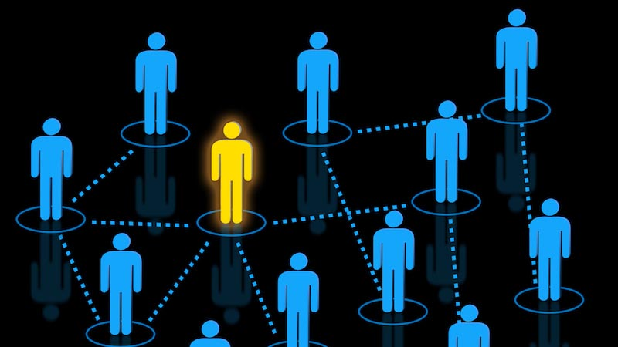
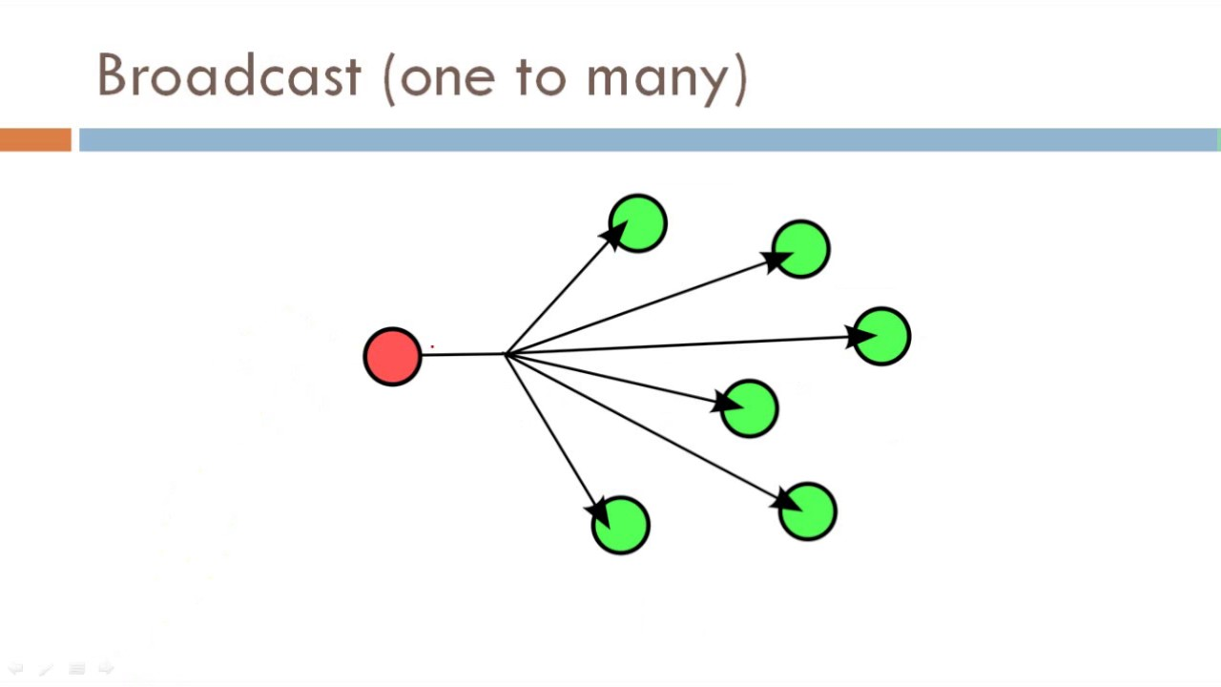
Peer to Peer & Broadcast
Peer-to-Peer is like mobile phone and Broadcast is like FM Radio.
Example of Peer-to-Peer protocols: Ethernet which uses Switch, SPI which uses CS.
Example of Broadcast protocols: CAN, Flexray
CAN Protocol is a Multicast (Broadcast) type.

Slide 11
Message Based Protocol
CAN protocol is message based protocol and not Node based protocol().
Each CAN frame is identified with Message ID and no info about the Tx or Rx node.
Node based Can be understood with mobile phones. Usually Peer-Peer are node based.
Since CAN is multicast, It is message based protocol.
Message ID has 3 purpose:
Identify the Data carried by the frame
Decides the message Priority and hence decides which frame gets the bus if clash happens.
Used in Message Filtering

Slide 12
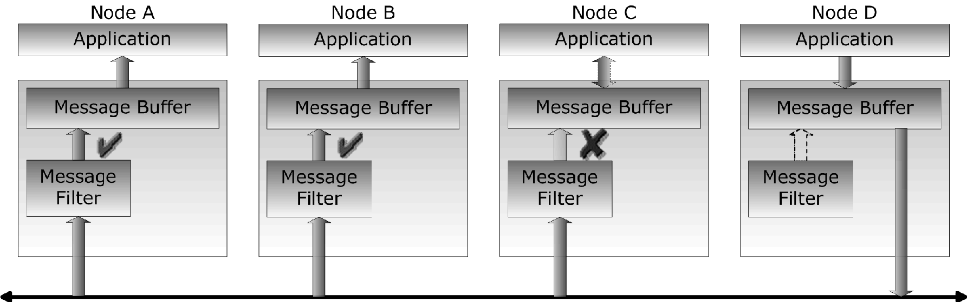
Message Filtering
Node D is transmitting the frame. Node A,B, C are getting the Message. Node A and B filters the message IN and Node C Filters message Out
Filtering of Frame happens depending on Message ID.
Message filtering happens within CAN controller hardware using 2 configured parameters called as mask and filter.

Slide 13
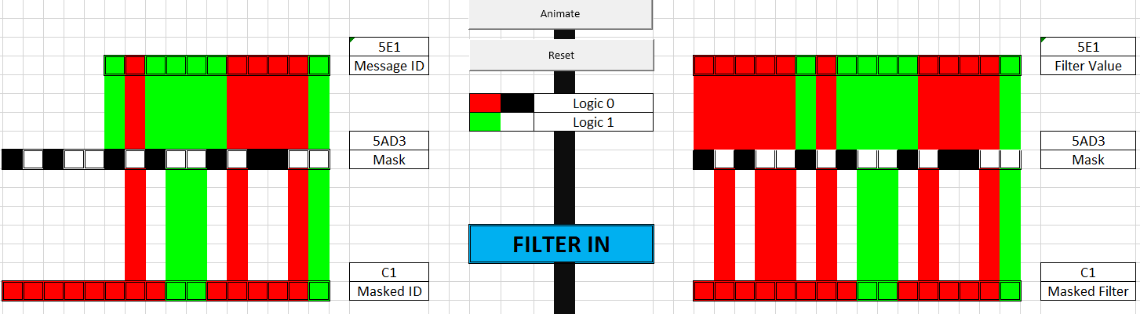
Message Filtering Logic
if (Message_ID & Mask) == (Filter_Val & Mask) {
Let the Message IN
}
else {
Ignore the Message
}
Msg ID : 5E1
Filter : 5E1
Mask : 5AD3

Slide 14
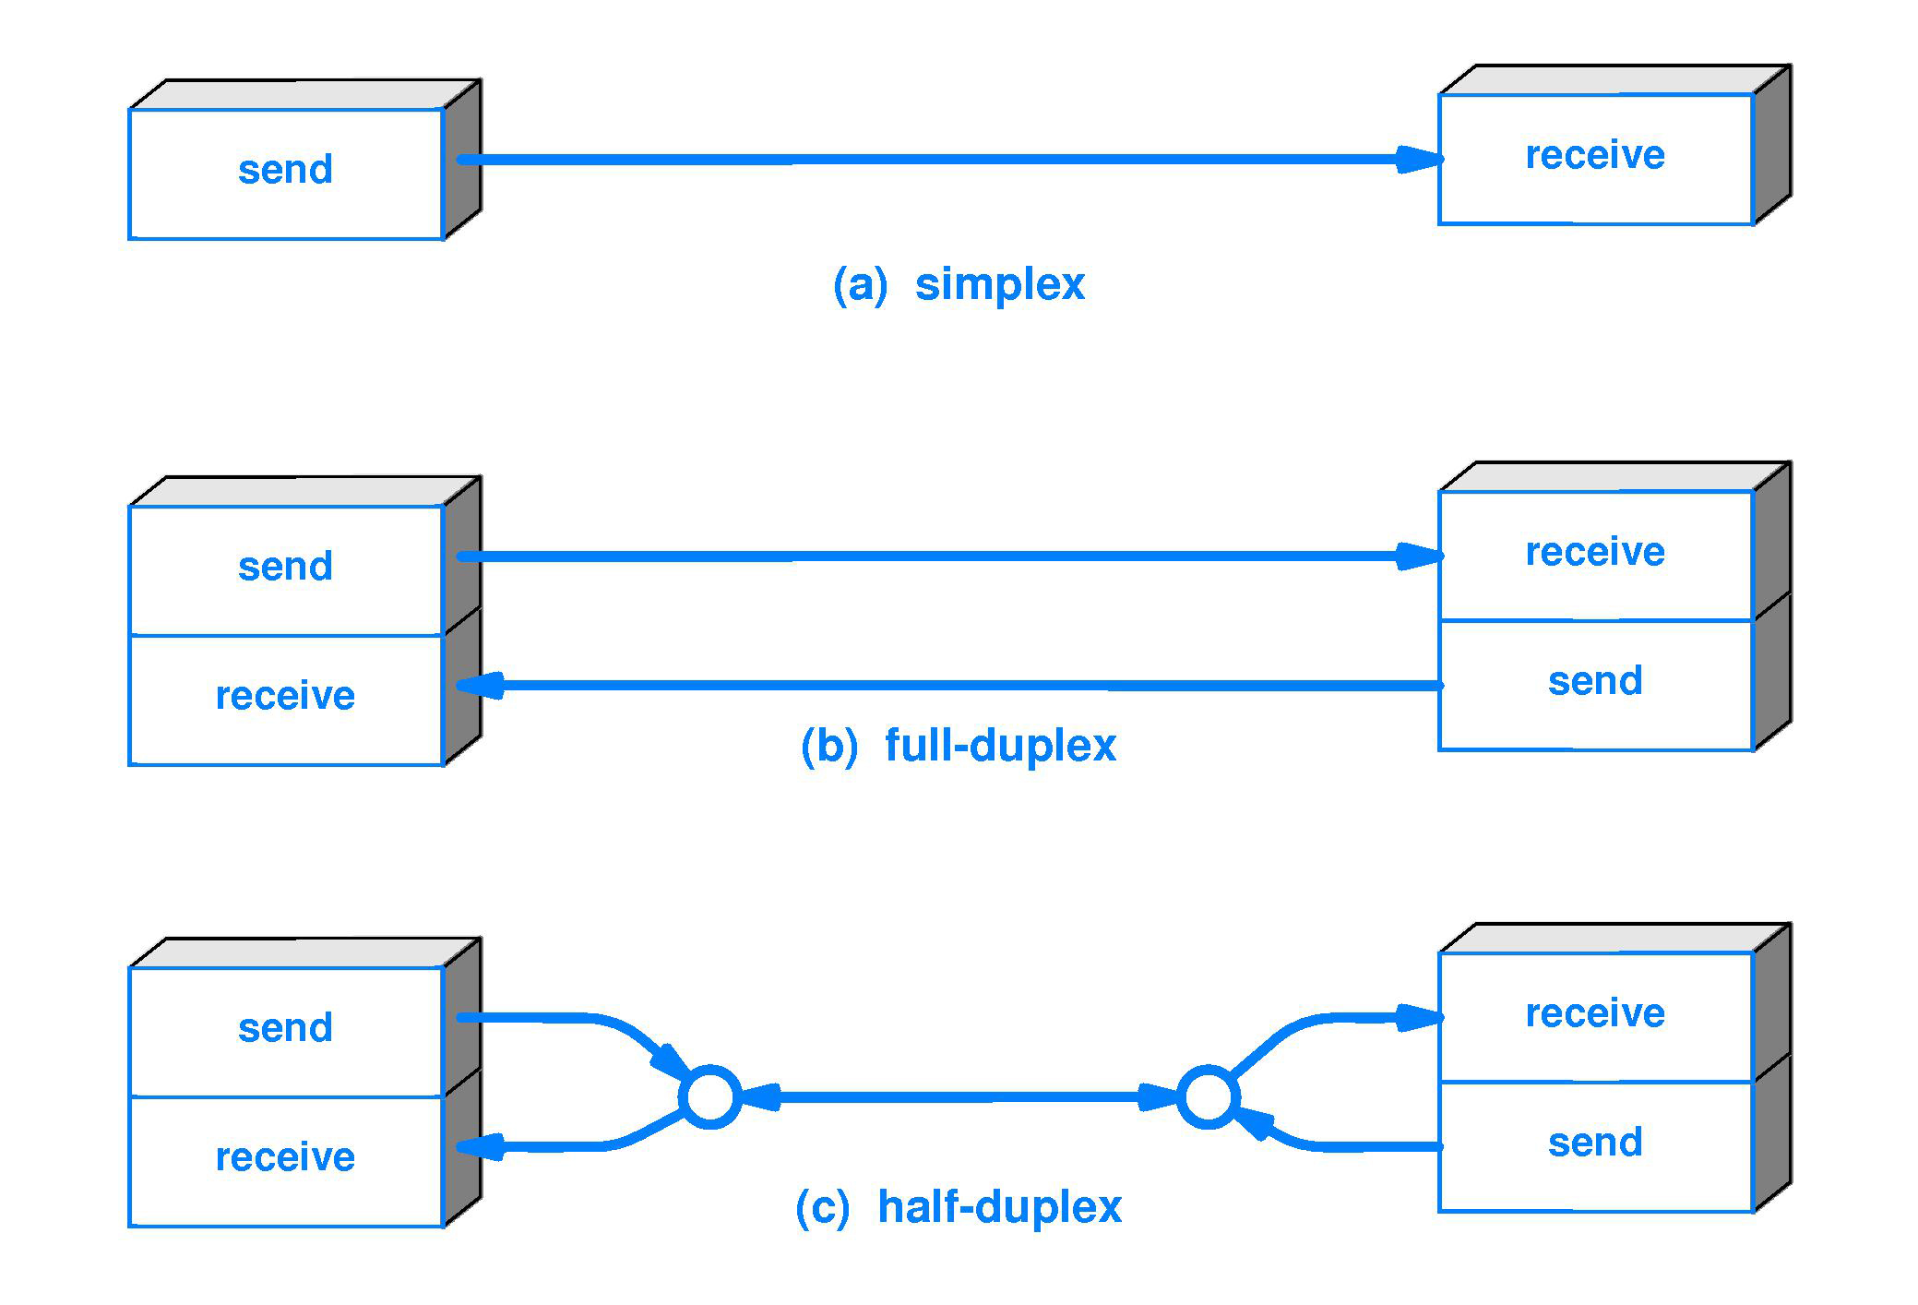
Simplex – Half Duplex – Full Duplex
CAN Protocol is a Half-Duplex Communication.

Slide 15
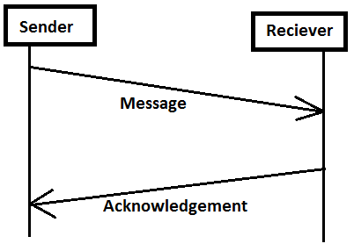
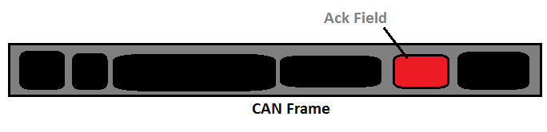
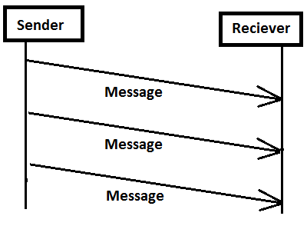
Acknowledgement Method
✖
There is no separate acknowledgement frame
In every frame, there is a special Acknowledgement field where The Receivers will acknowledge proper reception of data to them.
SO Ack is achieved without increasing the Bus load.
✓

Slide 16

CSMA-CA Protocol
CSMA-CA stands for Carrier Sense Multiple Access Collision Avoidance Protocol
I have a data to transmit
Listen to bus if any ongoing Tx
If free then only transmit
CSMA
BUS
CA
CD
CR
In CSMA : A transmitter attempts to determine whether another transmission is in progress before initiating a transmission using a carrier-sense mechanism
CA: Collision Avoidance 🡪 Doesn’t let collision happen between its frames
CD: Collision Detection 🡪 If collision happens between the frames, it is detected and a proper action taken.
CR: Collision Resolution 🡪 If collision happens between frames, its resolved in that instance only successfully.

Slide 17
Temporary and Permanent Node Failures
Temporary Node failure is when the current ongoing frame is destroyed by the node.
Permanent Node failure is when the node withdraws itself from the BUS communication (No Tx No Rx) due to many failures.

Slide 18
CAN Features
Agenda
CAN Speed
CAN Data
CAN Bus
CAN Controllers and Transceivers
CAN Network Topology
CAN in OSI model

Slide 19
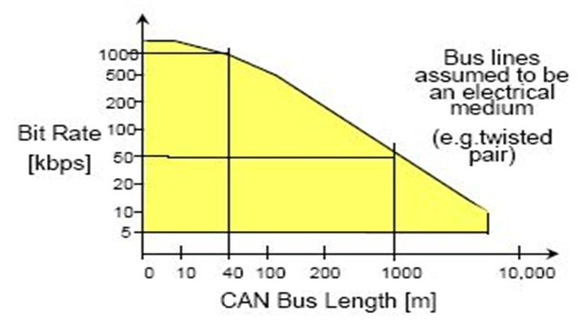
CAN Speed
CAN frames can go up to 1mbps speed with the bus length at max of 40 meters.
As the bus length increases above the maximum speed reduces.
In industry usually the CAN is configured at 500kbps speed
Lets say the baud rate is 500kbps 🡪 In 1 second, 500 *1000 bits can be transmitted
Lets say a single frame takes about 125 bits for example (without stuffing 111 bits)
So in a second the bus can fit around 2000 (500k /125) frames

Slide 20
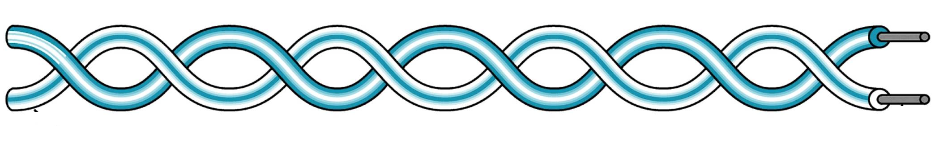
Data Limit
ECU 1
Application 1
ECU 2
Application 2
frame
Data
Frame has 2 parts: PCI() and Data
As per CAN protocol How much data can be sent in each frame? 🡪 8 Bytes
Is the data size variable? 🡪 Yes we can have 0 bytes or 1 byte or 2 bytes etc. Max is 8 bytes.
Is it possible to have data in bits? 🡪 No. Its in bytes. We cant have 2 bit or 27 bits etc its always in bytes.

Slide 21
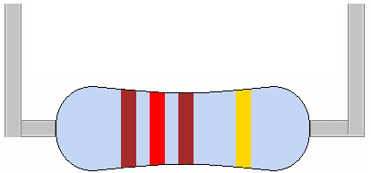
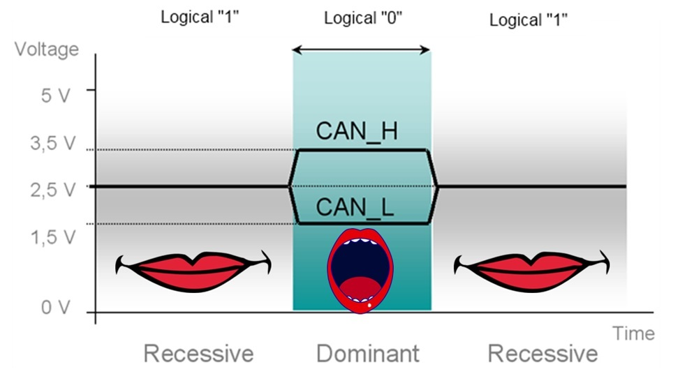
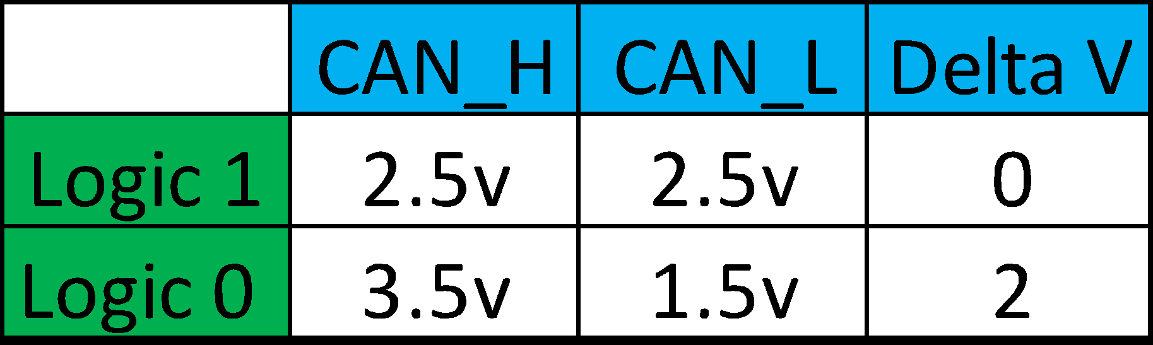
CAN Bus
120 ohm
Can High
Can Low
CAN bus is a Dual-Twisted pair wires called CanHigh and CanLow
Differential Voltage Logic
Logic1 = Recessive bit
Logic0 = Dominant bit
Why twisted pair? 🡪 Noise Immunity
Terminated with 120 ohm resistor 🡪 Impedance matching
=> Minimize the bounce back effect phenomenon, prevent reflective wave interfering with existing waves.
Micro controllers work with TTL (Transistor–transistor logic) and not CAN logic

Slide 22
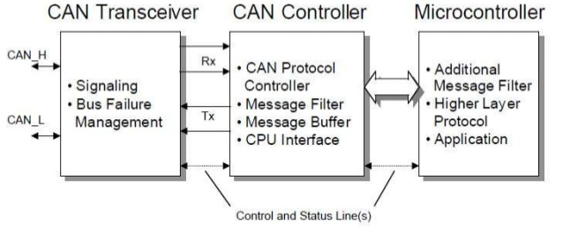
CAN Controllers and Transceivers
TTL logic (0-5V)
CAN Logic
In order to fulfill the need of a “translator” between CAN logic and TTL logic, CAN Transceiver was born to handle the signal conversion.
CAN controller:
TX: will form the CAN frame received from Microcontroller in TTL bits and the complete CAN frame is given to the transceiver.
RX: after receiving the CAN frame from CAN Transceiver, will remove all the controller specific protocol/fields and transfer the data part to Microcontroller
※CAN Transceiver & CAN controller does not have any SW, all implementations are done by HW

Slide 23
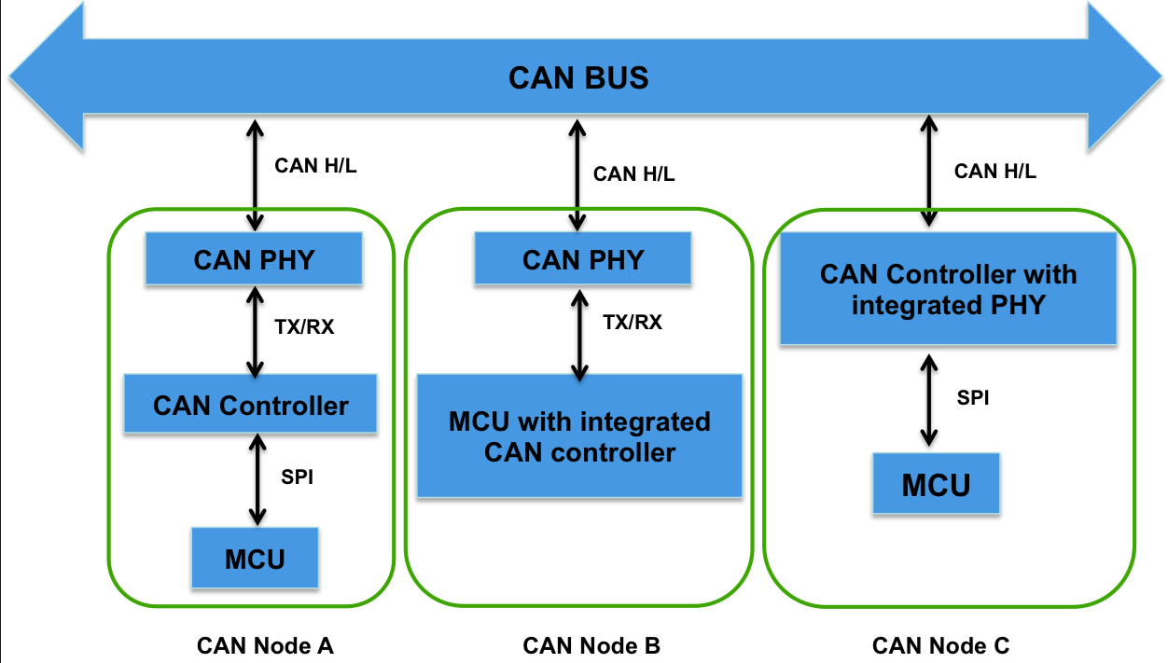
CAN Controllers and Transceivers
3 Architecture:
Transceiver & Controller off chip
Transceiver off chip & Controller on chip
Transceiver on Controller & chip

Slide 24
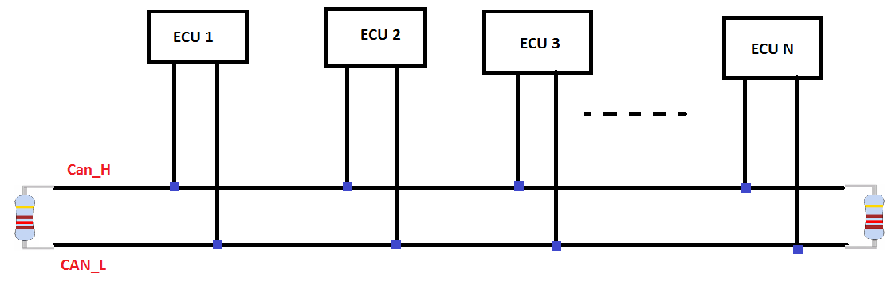
CAN Network Topology

Slide 25
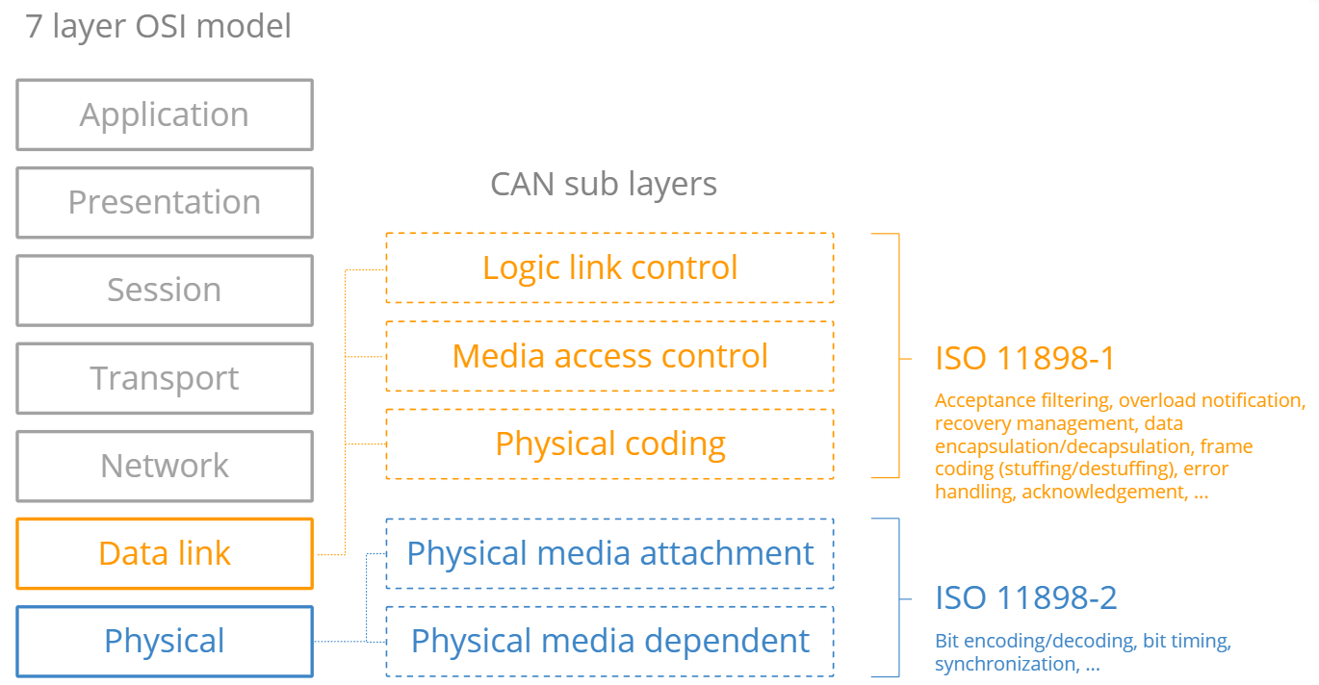
CAN in OSI model
ISO 11898-1
ISO 11898-2

Slide 26
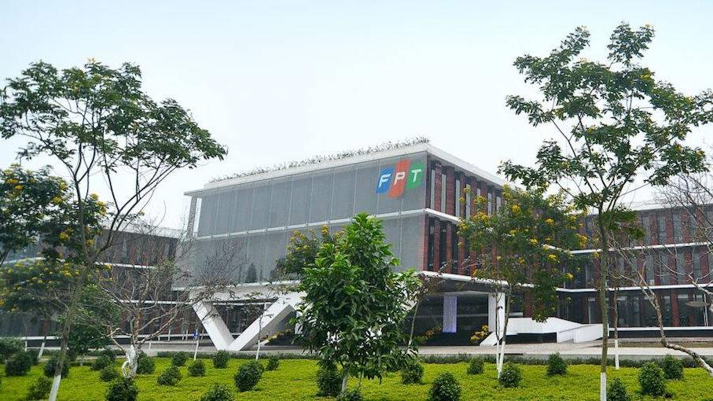

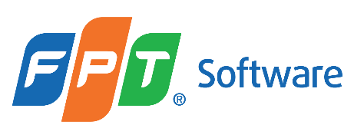
THANK YOU

